Slide 1
Game Integration using GITHUB
GITHUB

Slide 2
By end of this lab
Student will understand the basics of
Game Integration using GITHUB version control system

Slide 3
To complete this lab, you need
PC
GitHub Desktop client
GIT Cloud account
Unity Game Engine

Slide 4
Student A
Student A (Owner)
Create repository
Create Game project
Simple Maze game
Give access to your teammate
Check that your teammate can see the invite
Lab04_GroupName_Student A
Master branch
Unity Game Project
Merge Level 2 branch with Master branch
Student B (Collaborator)
Clone repository
Create a simple Level 2 game scene
Commit and push
Check that teammate that he/she can see your level 2

Slide 5
Student B
Student B (Owner)
Create repository
Create Game project
Simple Maze game
Give access to your teammate
Check that your teammate can see the invite
Lab04_ GroupName _Student B
Master branch
Unity Game Project
Merge Level 2 branch with Master branch
Student A (Collaborator)
Clone repository
Create a simple Level 2 game scene
Commit and push
Check that teammate that he/she can see your level 2

Slide 6
Form a team (3 members)
Student A
(owner of repository A and collaborator of repository B, C)
Student B
(owner of repository B and collaborator of repository C, A)
Student C
(owner of repository C and collaborator of repository A, B)
Grouping is in
MS TEAMS

Slide 7
Form a team (2 members)
Student A
(owner of repository A and collaborator of repository B)
Student B
(owner of repository B and collaborator of repository A)
Grouping is in MS TEAMS

Slide 8
Tasks to be completed for this assignment
Part A: Create a unity Project (Student A & Student B & Student C)
Part B: Set up GIT repository (Student A & Student B & Student C)
Part C:
Add your teammates as Collaborator
Update the existing projects

Slide 9
Part A: Create a unity Project
(Every student)

Slide 10
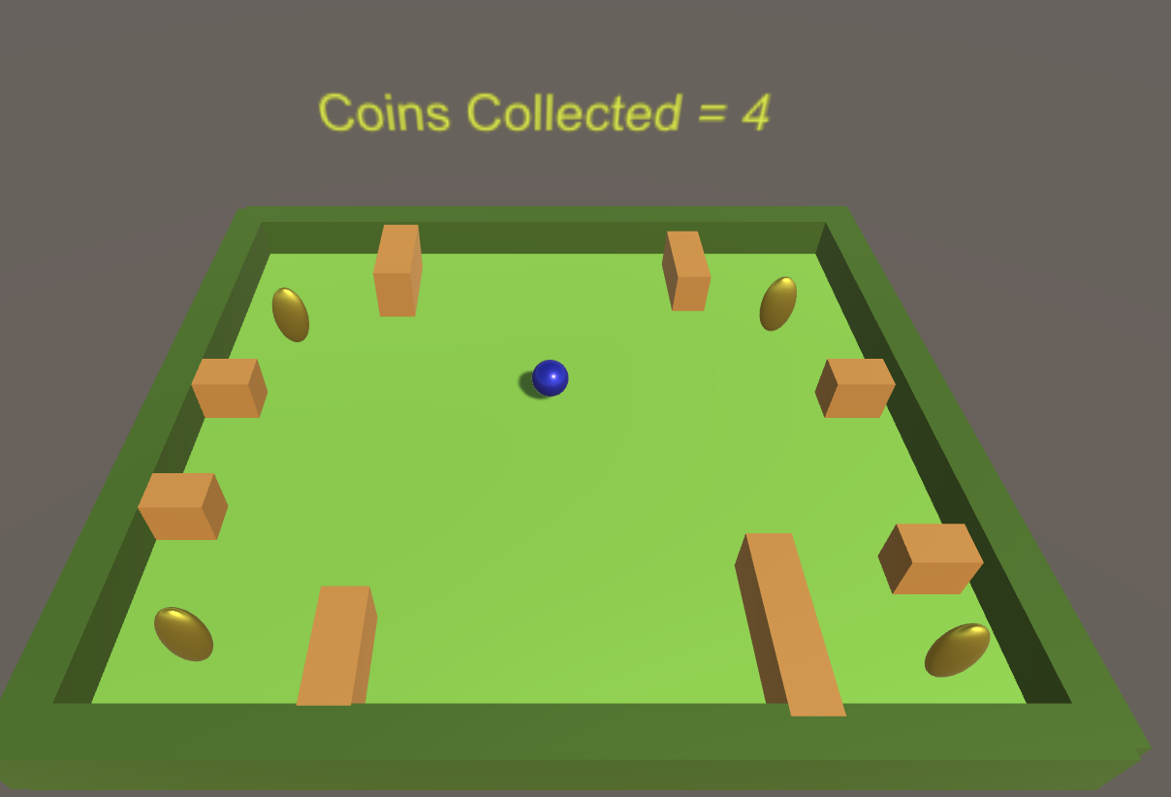
Step 1: Gameplay
Player is moved across the level to collect the coins
Collect all the coins to win the game
Touch any hazards, will lose the game
Player
Hazards
Coins

Slide 11
Step 2: Create a Unity project
Setup a GITHub Repo: IndexNumber_Name_Lab04
Create a unity project: IndexNumber_Name_Lab04
Create four folders inside Unity Assets folder:
Materials
Scenes
Prefabs
Scripts
Create a new scene and save it as GamePlay_Level1
Save the scene in Scenes folder
Design level 1 for the game
Player
Hazards
Coins

Slide 12
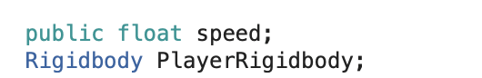
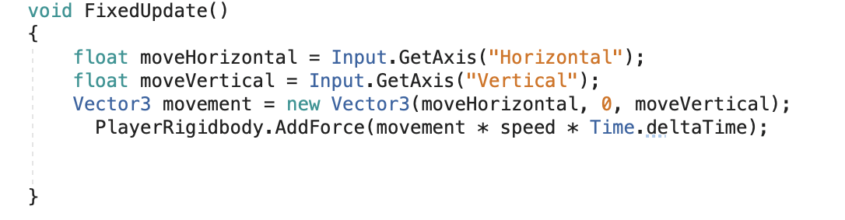
Step 3: Movement (reference)
Create a new C# script name it as PlayerMovement and save it inside Scripts folder
Apply the script to the player
Test the scene for player movement

Slide 13
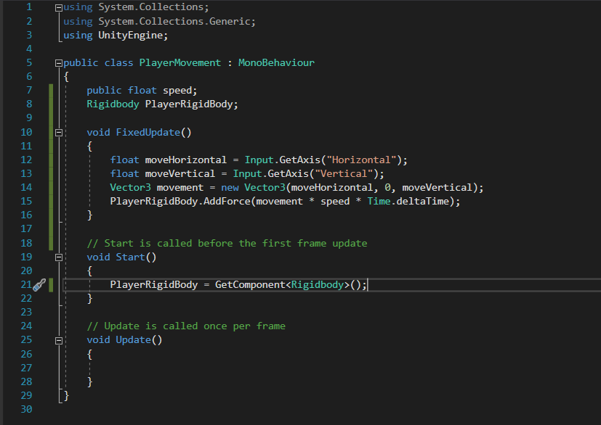
Step 4: level 1 layout
Paste your screenshot below

Slide 14
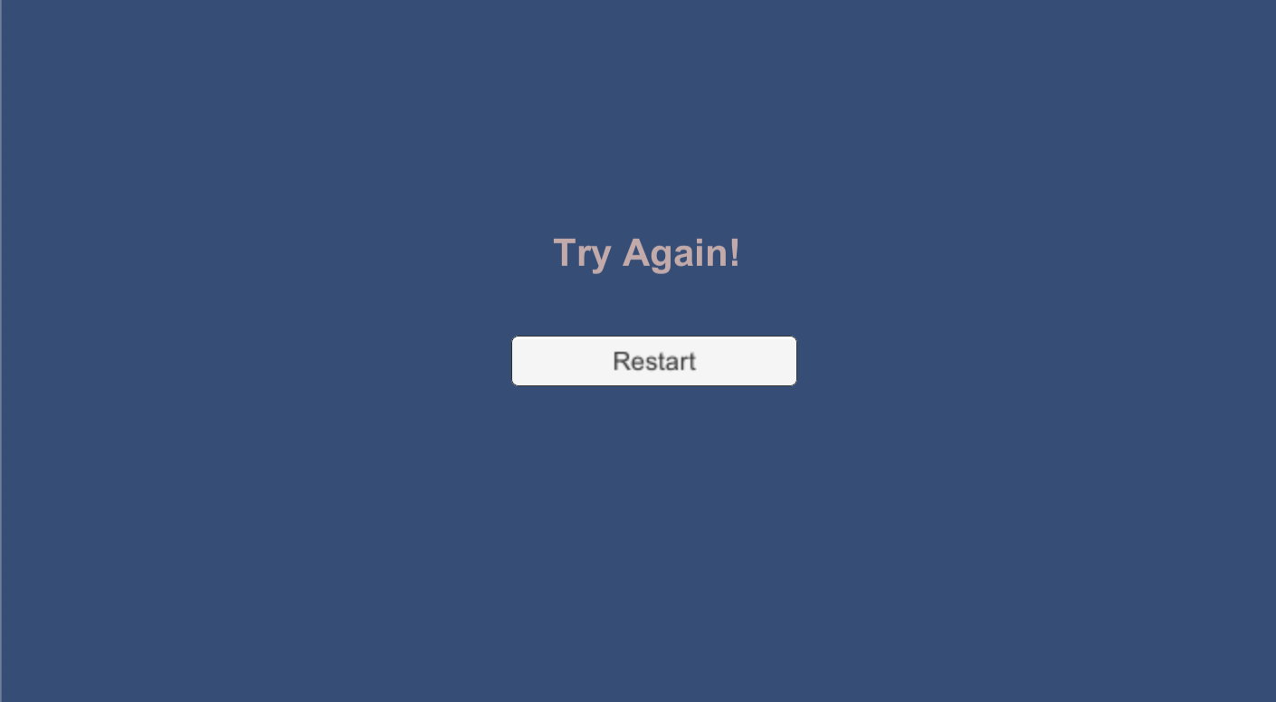
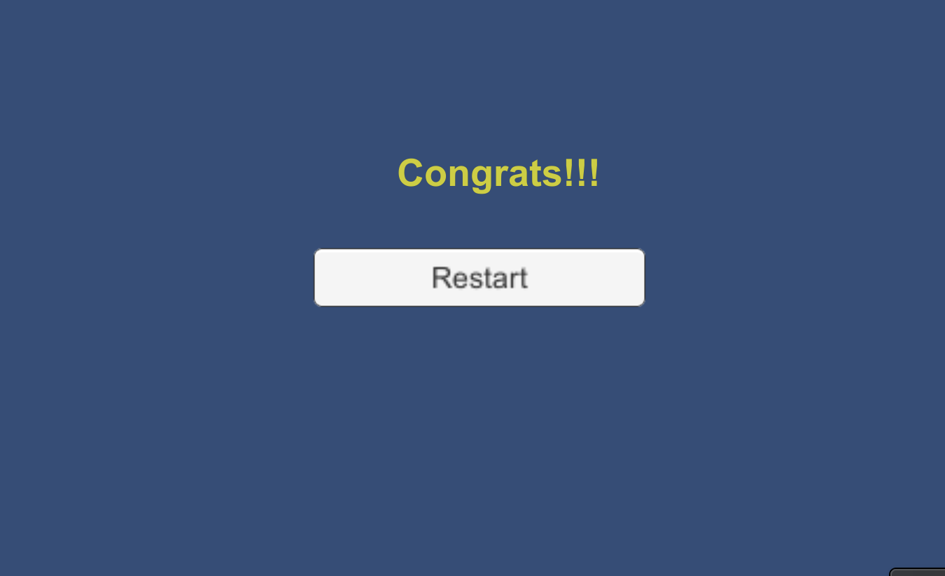
Step 5: GameWin and GameLose
Create scenes for GameWin and GameLose
Add a restart button to two scenes
Align the UI nicely
GameLoseScene
GameWinScene

Slide 15
Step 6: more features
Update the player movement script:
Win Condition
Increase score when collided with coin
Display the score in the canvas
Display GameWinScene when score reaches the total number of coins in the scene
Lose Condition
Display GameLoseScene when player collides with Hazards
Rotate the coins
Test the scene for required game play

Slide 16
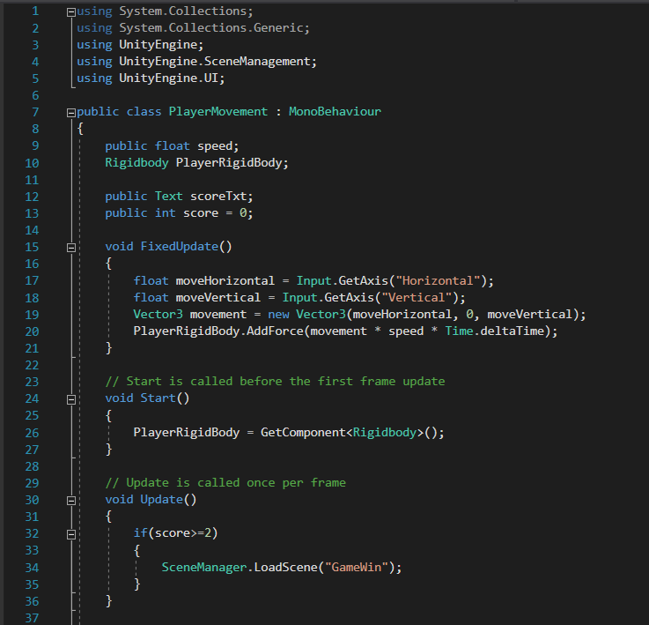
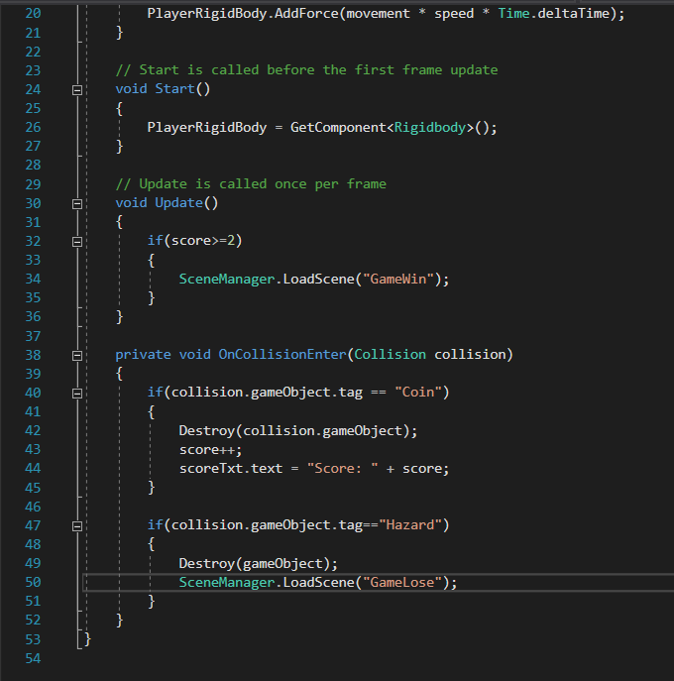
Step 7: PlayerMovement script
Paste the screenshot for updated PlayerMovement script below

Slide 17
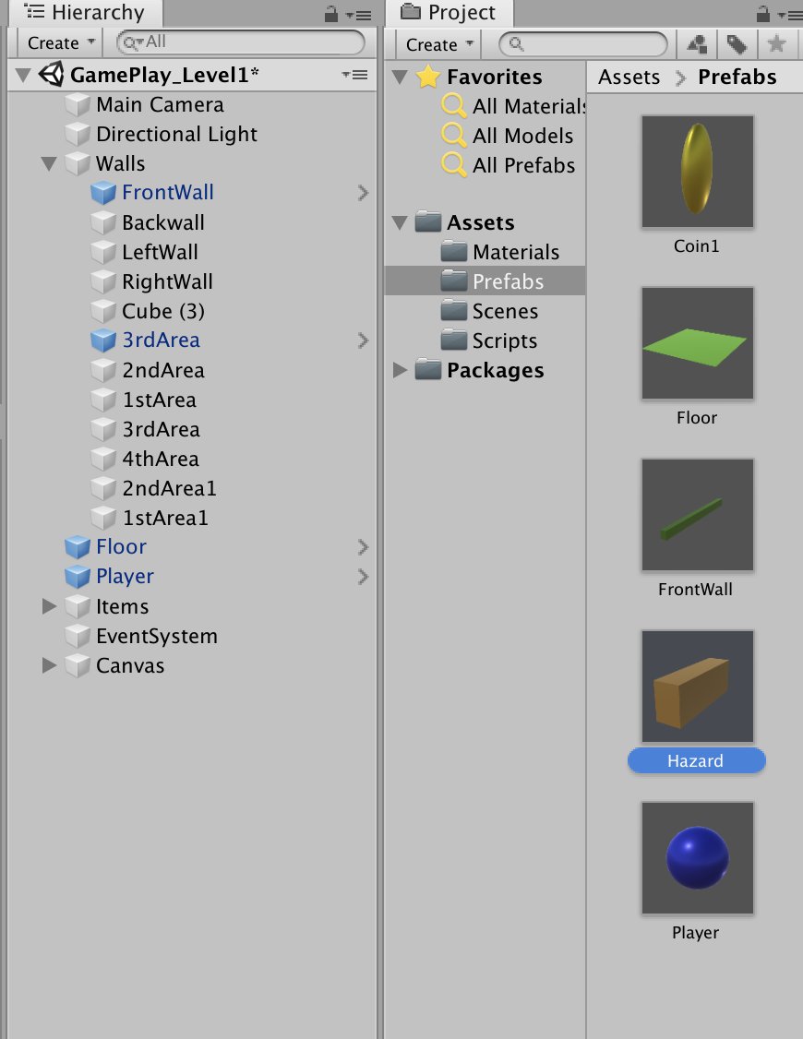
Step 8: Convert to Prefabs
Convert the following objects to prefab
Player
Floor
Coin
Wall
Hazard

Slide 18
Part B: Set up GIT Repository
(EVERY STUDENT)

Slide 19
Step 10: GitHub client
For both Student A and Student B
Login into GitHub client
Create a public repository and name it as IndexNumber_Name_Lab04
Commit the changes to Master/Main
Commit Message: Initial upload by YourName
Publish the repository

Slide 20
Step 11: Access to GitHub cloud
Access to GitHub Cloud and verify the contents for master branch
Invite a collaborator to your repository
Before performing this step, get the email address of your collaborator
Student A need to add in Student B’s repo
Student B need to add in Student A’s repo
Access to GitHub Cloud
Click Settings > Manage Access > Invite a Collaborator

Slide 21
Part C: Collaborator access to the repository
Update the existing project

Slide 22
Step 12: Accept the invite
Invited collaborator will receive an email
Click the link provided in your email to accept the invitation

Slide 23
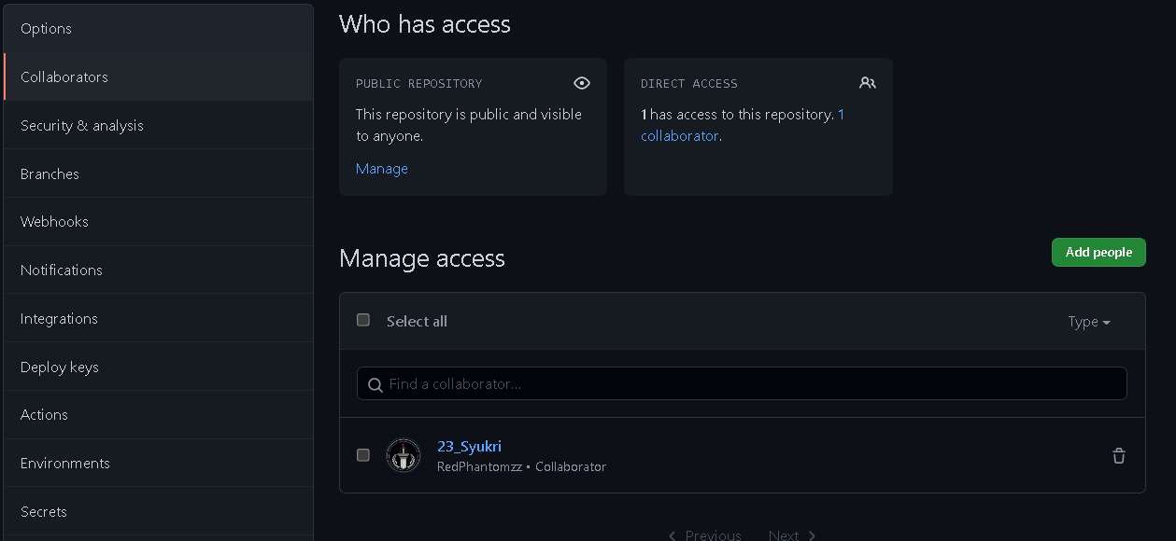
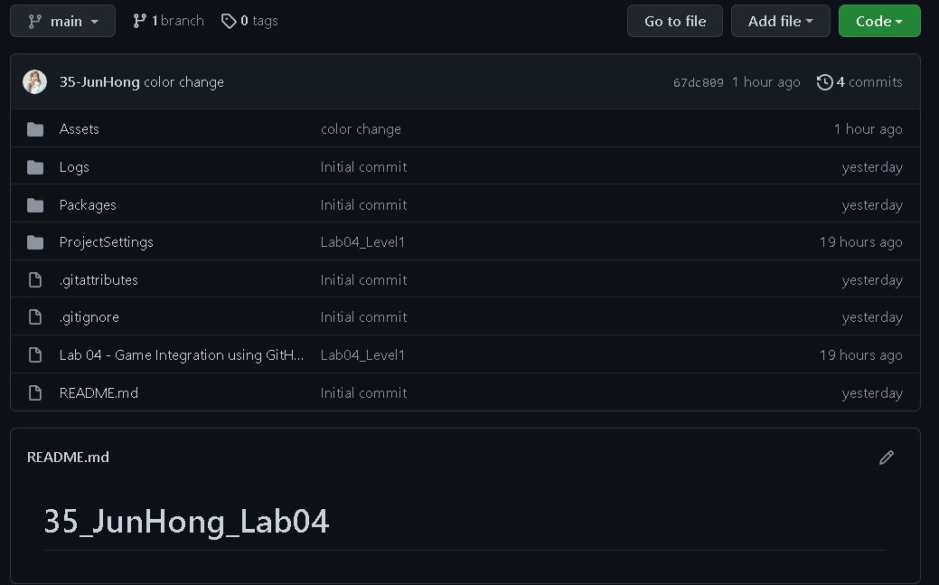
Step 13: Invited collaborator
Paste the screenshot below

Slide 24
Step 14: Clone repository
Clone the repository to your local GitHub client
Student A clones the repository created by Student B
Student B clones the repository created by Student A
File > Clone Repository > URL

Slide 25
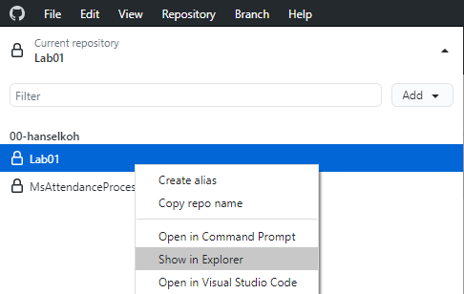
Step 15: Update the Unity project
Click Show in Explorer in GitHub Client
Open the Unity project from the folder
Design a new scene and name it as Level 2
Using the prefabs given, design the Level 2 layout
Level 2 design must be different from Level 1
You can add in other objects if you would like to
Game play for Level 2 will be same as Level 1
Add in text like “Designed by YourName”
Update the game flow
Game Win condition
Game Level 1 > Level 2 > GameWinScene
Game Lose Condition
Game Level 1 or Game Level 2 > GameLoseScene (When player collides with the hazard object)

Slide 26
Step 16: Play and Test
Test the game for game play requirements
Save and close the unity project

Slide 27
Step 17: Update in Desktop client
From GitHub Desktop Client
Click > Show in Explorer
Check the list of changes you made
Add in a commit message “Updated <the changes your made>”

Slide 28
Step 18: Access to GitHub cloud
Access to Github cloud
Verify the new contents
Update your other team member about the changes in the repository

Slide 29
Step 19: Verify unity project
Test the unity project and verify the game requirements
(you should be able to see level 2)

Slide 30
Step 21: URL for submission
Paste the URL to your GIT repo below

Slide 31
Step 22: Submission
Save this PPT slide as IndexNumber_Name_Lab04.pptx
Remove the slides that are instructions
Leaving only the slides that you copy and pasted
Step 4, 7, 13, 21
Test your GIT URL link before submission
Zip the Unity folder IndexNumber_Name_Lab04 and Upload to MyConnexion

